Slide 1
An Exploratory Data Analysis of Unicorn Companies by Ife Olugbekan

Slide 2
FINDINGS
Twelve(12) Unicorn companies did not have Return on Investment, based on the fact that they did not put any funds in place.
Four of the Unicorn Companies had a Return On Investment of -50%. They made a huge loss with an investment funding of 2billion dollars each, valued at 1billion dollars each. So they are completely at a loss of $1B each.
Five(5) of the Unicorn companies also made 0.00% on their Return on Investment. They actually got funding of a billion dollars each and they were valued at one(1)billion dollars each as well, which did not give them any return on their investment.

Slide 3
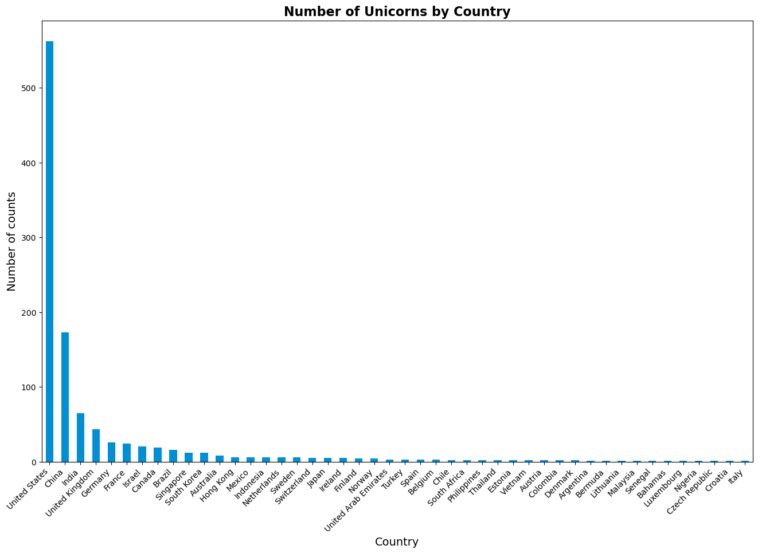

Slide 4
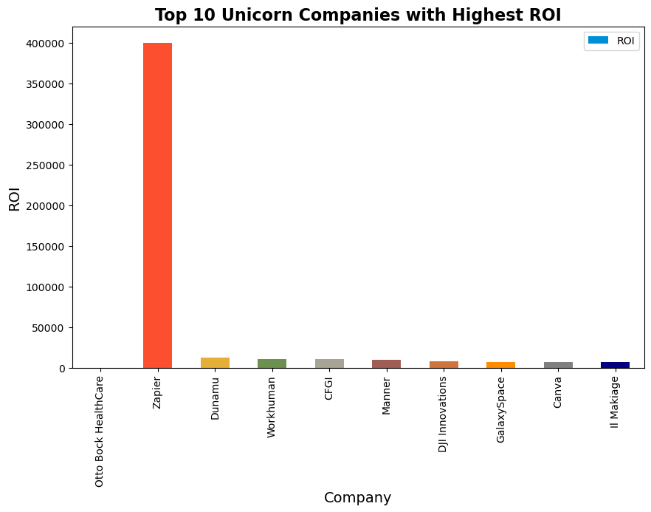

Slide 5
The Unicorn Company with the highest Return on investment
Here, the Unicorn company with the highest return on investment is Otto Bock HealthCare with an infinite value. This value shows a positive infinite value, which means that an infinite value for ROI usually occurs when the initial investment is zero or negative. This means that the company has not invested any money, or has lost money, and is generating positive returns. In this case, the ROI is undefined or infinite.
Followed by 'Zapier' at 399900% and 'Dunamu' at the third position with 12577%.

Slide 6
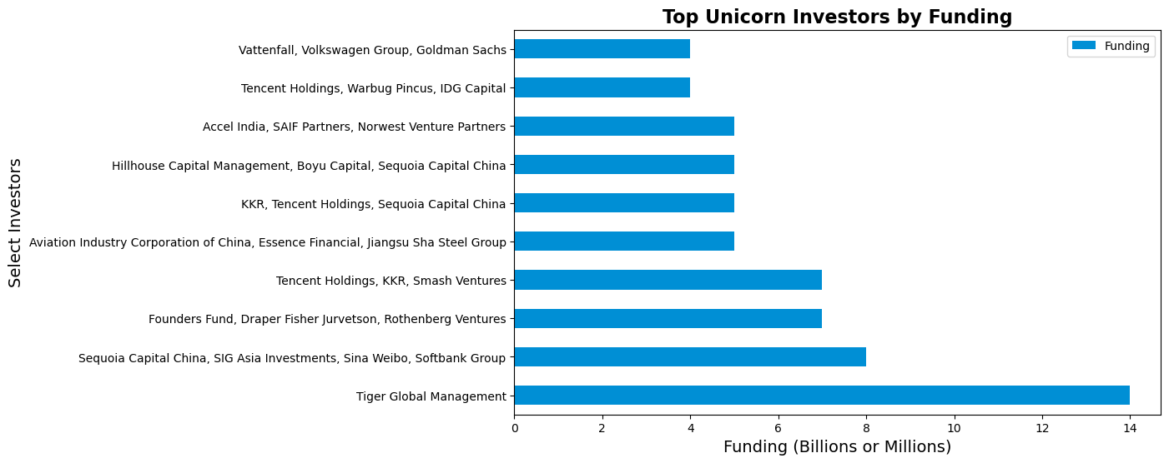

Slide 7
Investors that have funded the most in the Unicorns
Here, TIGER GLOBAL MANAGEMENT has funded more with a funding of $14billion dollars.
It funded 'JUUL Labs' company, a Consumer Retail Industry based in the United States, in the city of SanFrancisco and founded in year 2015.
Followed by Sequia Capital China, SIG Asia Investment, Sina Weibo and SoftBank Group with a funding of $8billion dollars. They all funded Bytedance company, an Artificial Intelligence company based in Beijing, China.

Slide 8
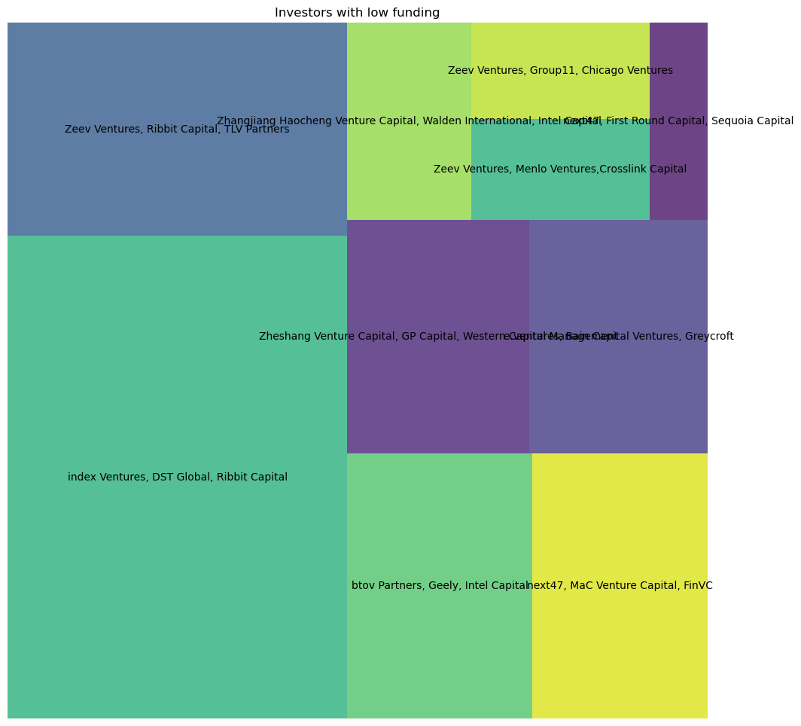

Slide 9
Investors with the lowest funding
Observe that next47, First Round Capital, Sequoia Capital are the least Investors at the bottom 10 with funding of 139million dollars.
Followed by Zeev Ventures, Group11, Chicago Ventures with a funding of 210million dollars.

Slide 10
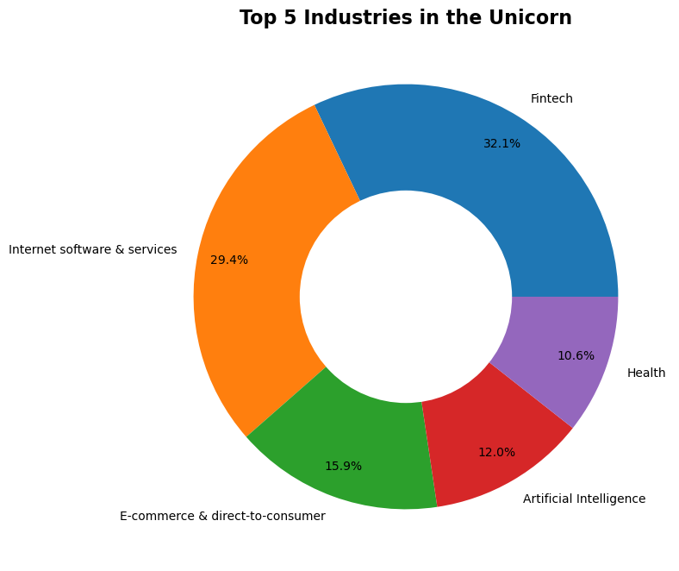

Slide 11
The top five(5) prominent Industries in the Unicorn
There are 16 Industries existing in the Unicorn Companies, and Fintech is leading with a 32.1% presence followed by Internet Software & Services at 29.4%.

Slide 12
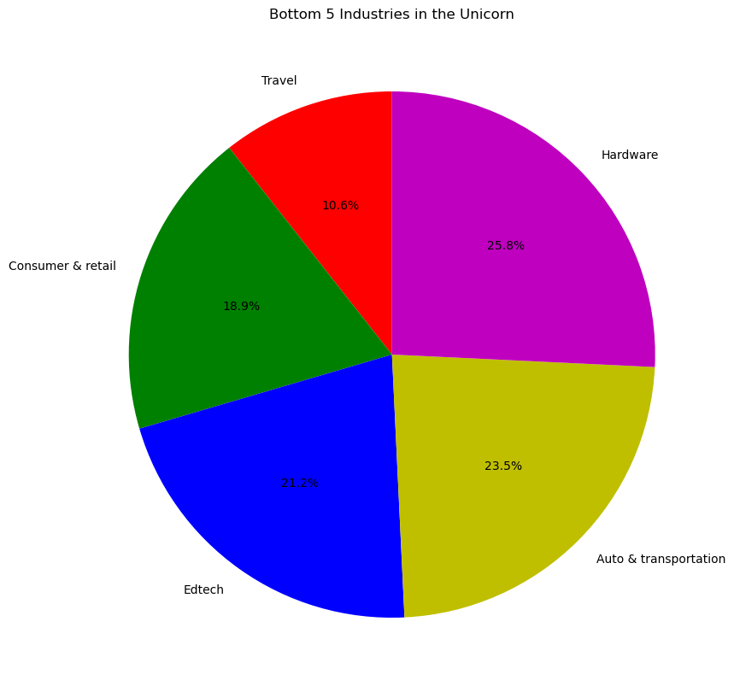

Slide 13
The five(5) least Industries in the Unicorn
We can observe that the least industry is TRAVEL with a 10.6% presence in the unicorn company.
This is followed by CONSUMER and RETAIL which has 18.9% presence.

Slide 14
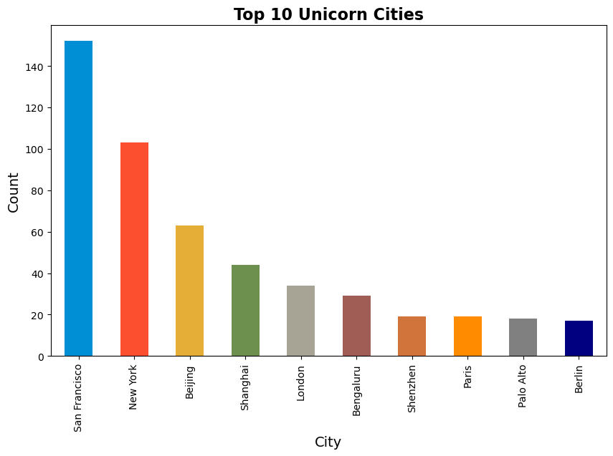

Slide 15
The Cities that has the most Unicorn presence
We can see that San francisco has the highest number of unicorn presence with a count of 152 companies , followed by New York with a count of 103 companies.

Slide 16
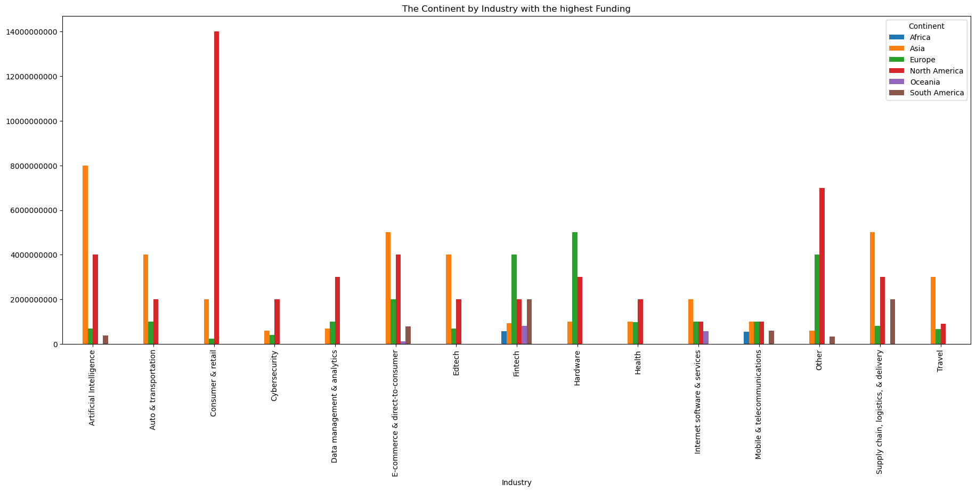

Slide 17
The Continent and industries with the highest Funding
We can observe that the continent with the highest funding is NORTH AMERICA in the CONSUMER & RETAIL Industry.
This is followed by ASIA in the ARTIFICIAL INTELLIGENCE Industry.
The lowest funded continent is OCEANIA in the E-COMMERCE & DIRECT TO CONSUMER Industry.

Slide 18
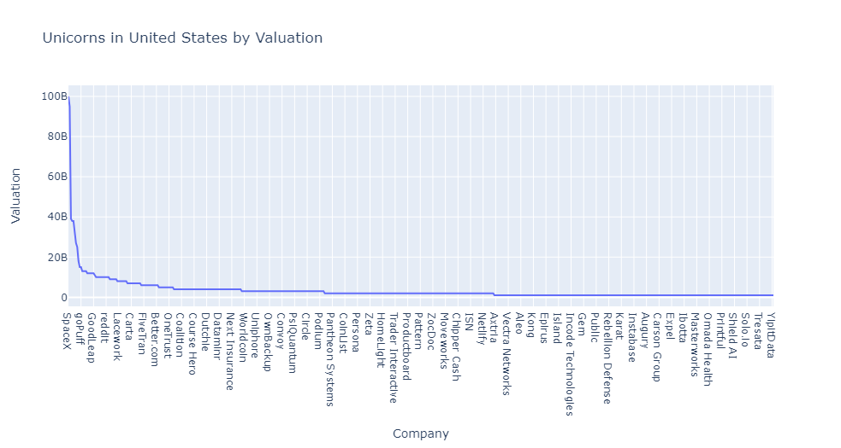

Slide 19
Unicorn Companies in United States by their Valuation
United States has the highest number of companies, hence the need to look at its companies valuation.
SPACEX company in the city of Hawthorne, United States is with the highest valuation of a $100billiom dollars.
STRIPE, a Fintech company based in San Francisco is in the 2nd place with a valuation of a $95billion dollars.
While ZWIFT, an E-Commerce & direct-to-consumer Industry based in Longbeach in the United States is with the lowest valuation of one(1) billion dollars.

Slide 20
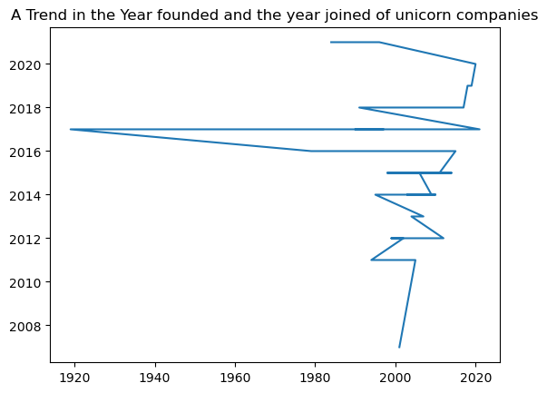

Slide 21
Trend in the year companies were founded and year they joined the league of Unicorns
The company founded in 1919 ‘Otto Bock HealthCare’ joined the leagues of Unicorns in the year 2017. It took this company a whooping 98years to join the unicorns which is the longest in the league of unicorns.
Followed by ‘Promasidor Holdings’ founded in 1979 and joined the unicorns in 2016, also Five Star Business Finance founded in 1984 but joined the unicorns in 2021. it also took these two(2) companies 37years to join the unicorns.
Meanwhile, it took zero year for nine(9) companies in the unicorns to join this league, because they all joined the same year they came into existence.
While ‘Yidan Zixun’ is the only company that joined the Unicorn 4years before it was founded. This could be it must have been in existence for a while before it joined the Unicorn Companies in 2017 but changed its name to 'Yidian Zixun' in 2021 when the name was founded or when it was transitioned. Its Investors could have also contributed to this decision.

Slide 22
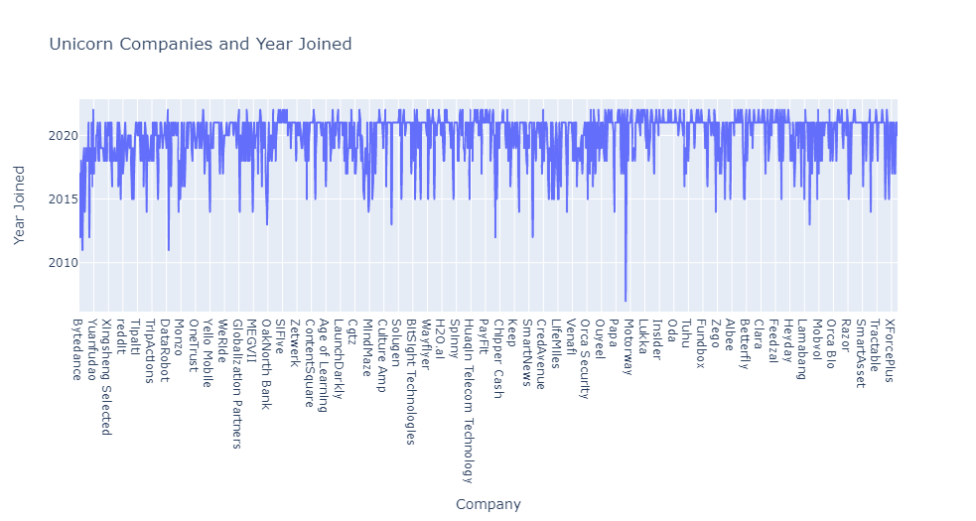

Slide 23
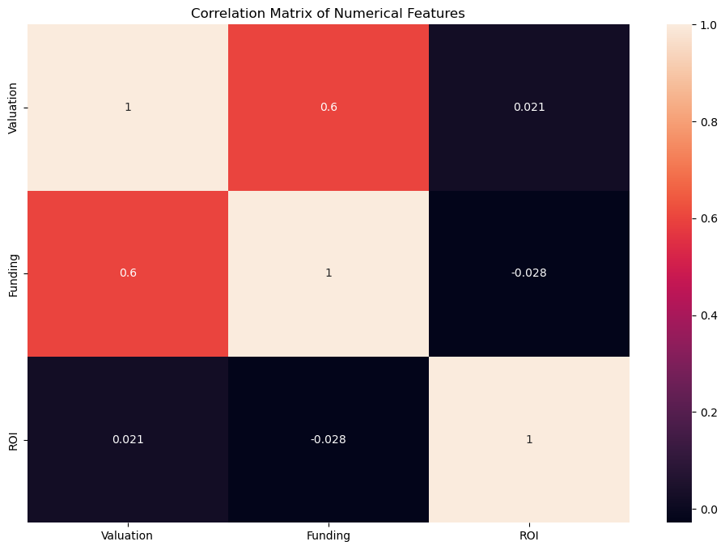

Slide 24
OVERALL RECOMMENDATIONS
1 - I recommend that Unicorn Companies with a high potential growth such as 'Otto Bock HealthCare', 'Zapier', 'Dunamu', 'Workhuman' and the rest on top of the list with a high return on investment should:
Keep and continue to maintain their standards, policy, staff and stakeholders while ensuring policies are in check from time to time.
Be more innovative, proactive and creative to be ahead of their competitors.
Increase their customer service and awareness in other cities within their current states and gradually to other states.
Work with their finance team to Control their costs and spending because growth sometimes can mean more spending.
'OTTO BOCK HEALTHCARE' company should forecast its funding so as too woo more Investors likewise increase valuation.
2 - It is necessary for all Unicorn Companies to diversify their Investment portfolios, especially those with a just one Investor like 'Otto Bock HealthCare', 'Black Unicorn Factory', 'ISN', 'Carson Group' and the likes.
Unicorns should diversify their Investment portfolios as part of risk management and volatility within and across different assest classes.
They should take advantage of asset classes different from their sectors, such as Treasury bonds which is safer because they have government backing, also Real assets as buildings & Properties and barrels of oil or commodities.
They should also invest in asset classes within their industries, for example, companies who invest in Energy stocks should also consider Technology, Utility, Biotech and Retail.
Unicorn companies should also consider diversifying by location such as Foreign stocks and bonds.
They can also hire finance and risk experts or advisors to help them keep in check their investments and rebalance their portfolios regularly.
3 - Unicorn companies with experienced leadership teams such as 'Otto Bock HealthCare' with 98years of experience, 'Promasidor Holdings', and 'Five Star Business Finance' with 37years experience each, 'Thirty Madison' of 28years and 'Radius Payment Solutions' of 27years should continue to understand their motivations, strengths and weaknesses.

Slide 25
They should facilitate open communication, encourage employee growth and development, also give and receive performance feedbacks.
They should continue to reiterate good standards and policies, and be clear on their objectives and goals.
Encourage innovations and creativity to stay up to date and take on challenges and stay positive as well.
Effective management is imminent, likewise focus on their ROIs and ensuring its increase yearly.
4- For Companies with the least or no return on investments including those that ran at loss such as 'Leap Motor', and 'Momenta' at 0.0%, 'Zhuan Zhuan' at 1.0%, 'Miaoshou Doctor' at 6%, 'Fair' at -50%, 'Magic Leap' at -33%, 'ISN', and 'SITECH DEV' with no ROI, and the rest that fall under these categories,
I recommend that these companies conduct a SWOT analysis, and focus on their strengths and weaknesses. Each of them should identify what their strengths are and leverage on them. They should also manage their weaknesses.
Manage cashflow efficiently. Proper cash flow management can prevent business failure and ensure smooth running.
Put a business contigency plan in place and put them to test. This will help prepare them for the worst case scenario.
Build effective customer relationships.
In general, all Unicorn companies should invest in their strengths and what makes them grow.
Finally, Marketing strategies such as heavy Social Media presence, Promotional Strategies, changing of product/service sales strategy would also help in increasing their Return on Investments and also attract more investors.

